Slide 1
Does Rust SPARK joy?
Recommendations for safe cross-language
bindings between Rust and SPARK
Aïssata Maiga
Supervisors: Cyrille Artho (KTH), Florian Gilcher (Ferrous Systems), Yannick Moy (AdaCore)
Examiner: Elena Troubitsyna

Slide 2
Problem
FFI, or Foreign Function Interfaces = interface two languages
Software is built in several languages in safety critical, mostly C/C++ and Ada/SPARK, Java for high-level ...
Usually done with C/C++ (low level, fast) but too much freedom = too much responsibility!

Slide 3
Research question
Goal: Recommendations for binding Rust and SPARK by preserving type and memory safety, as well as ownership
Limitations: Preliminary research from automated tool!
Future work! → 1. performance, 2. sustainability impact, 3. industrial integration and maintenance, 4. generalization

Slide 4

Background 1: Ferrocene
How many planes?
Ferrous Systems/AdaCore project
Qualification of one version of the Rust compiler
Produce certified code

Slide 5
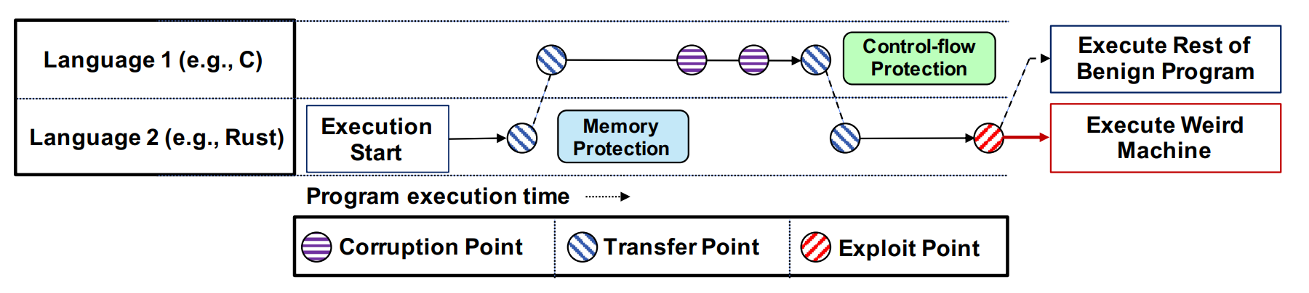
Background 2
Memory errors come from unsafe languages[1] → safety-critical, systems programming, low level
FFI in software engineering is difficult and error prone, reason in new paradigm [2]
FFI safe/unsafe languages is potentially more unsafe than the rest! [3]
FFI resuscitate old avenues of attack → weakest link
Cross-Language Attacks (CLA) transfer back and forth
between languages to circumvent deployed defenses.
Mergendahl et al., [2]

Slide 6
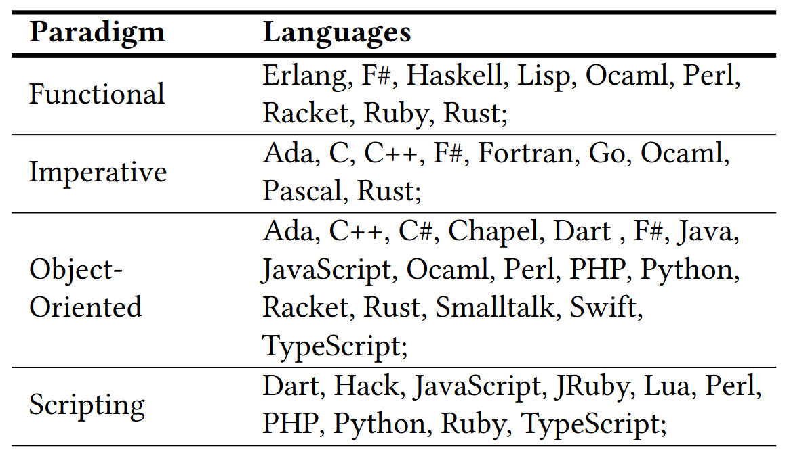
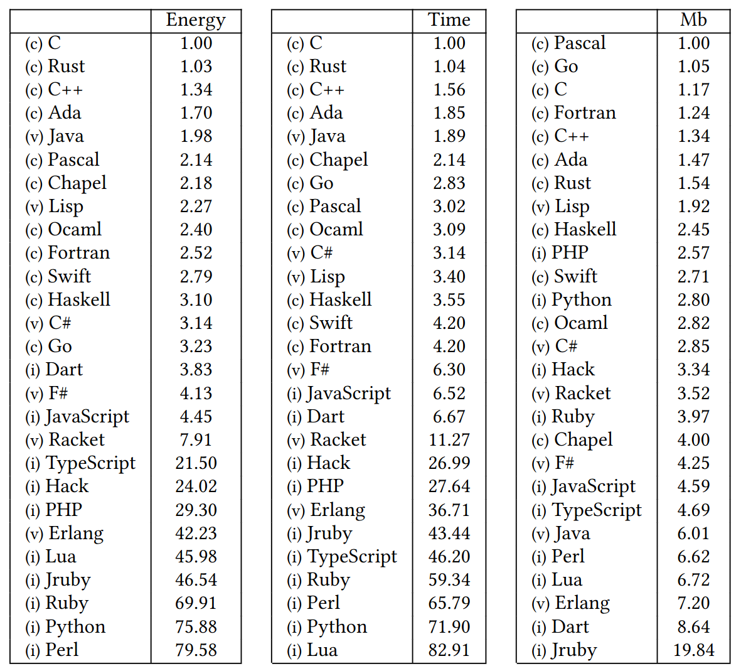
Background 3: Rust and SPARK
Energy Efficiency across Programming Languages
How Do Energy, Time, and Memory Relate?
R. Pereira et al.[3]

Slide 7
Background 4: Rust safety guarantees
Rust has type safety, memory safety and ownership
Unsafe Rust allows to deviate from the borrow checker but invariants must be followed
Unsafe Rust limited to 4 operations:
Dereference a raw pointer
Call an unsafe function or method
Access or modify a mutable static variable
Implement an unsafe trait
Invariants example
Safety
Behavior is undefined if any of the following conditions are violated:
1. data must be valid for both reads and writes for len * mem::size_of::<T>() many bytes, and it must be properly aligned. This means in particular:
1.1 The entire memory range of this slice must be contained within a single allocated object! Slices can never span across multiple allocated objects.
1.2 data must be non-null and aligned even for zero-length slices.
...
https://doc.rust-lang.org/beta/std/slice/fn.from_raw_parts_mut.html

Slide 8
Background 5: SPARK safety guarantees
SPARK: biggest possible subset of Ada with specification and sound verification
Pointers ownership rules added in 2019, forbids aliasing, allows begning aliasing (“observing”)
Support for mathematical proofs:
absence of runtime exceptions
verify the fulfillment of security and safety properties
or establish that the software follows its specifications/behavior

Slide 9
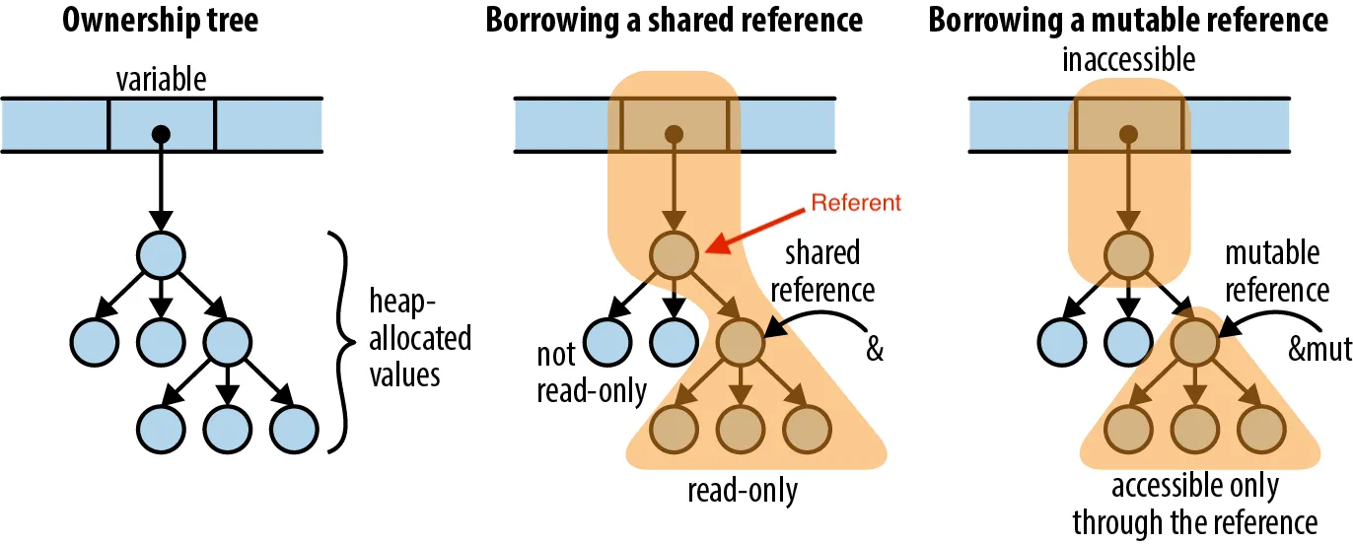
Background 3: What is ownership?
“Understanding Ownership”
Luis Soares [5]
Rust ownership:
- one place in memory has one owner
- the compiler annotates the types with lifetimes
- the compiler removes the memory when the owner is out of scope.
SPARK ownership:
- inspired by Rust
- the programmer need to implement deallocating functions
- the compiler will not throw an error in case of illegal operations

Slide 10
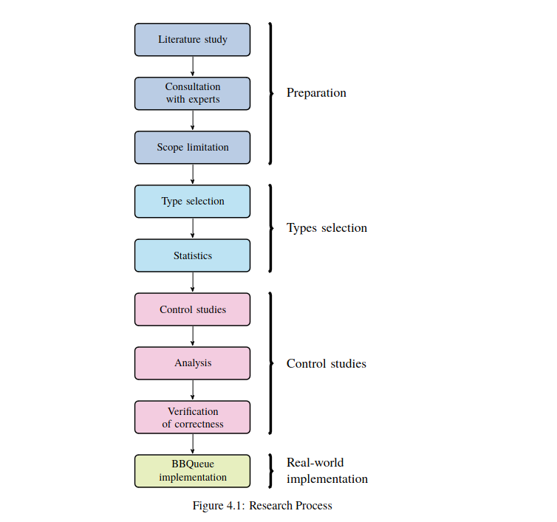
Method 1: Overview
Method

Slide 11
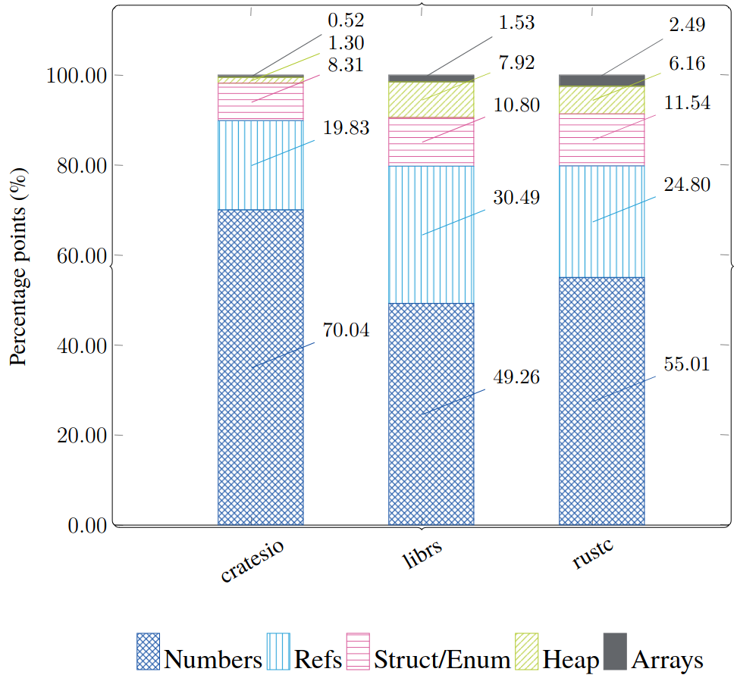
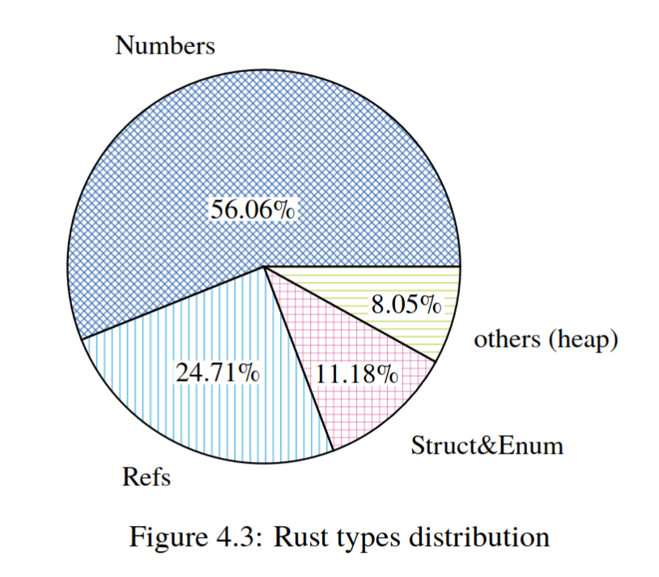
Method 2: Rust Type selection
- About 2MLoC
- Compiler, crates.io, lib.rs (17 important rust projects)
- A systems’ programming language profile.
Method

Slide 12
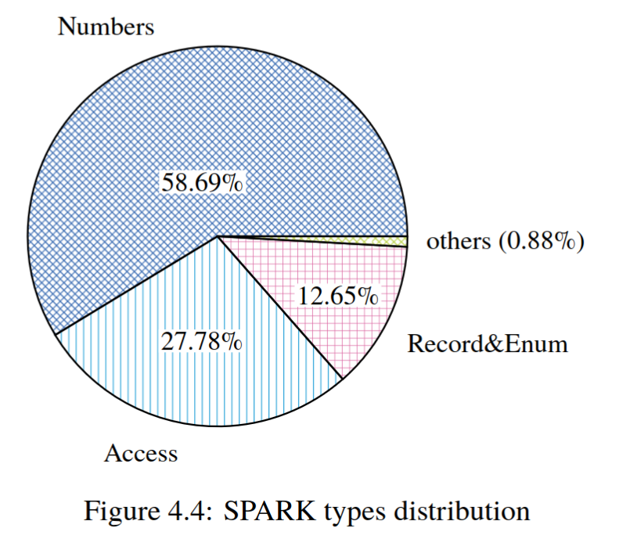
Method 3: SPARK Type selection
- 27 kLoC for SPARK
- Code base are proprietary → Three OSS projects + Expert
- Low-level language, very little heap types
Method

Slide 13
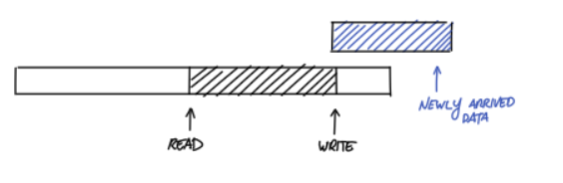
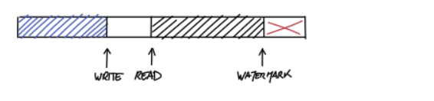
Method 4: BBQueue
Bipartite Circular Buffer, multithread FIFO queue
Optimized for DMA in embedded systems
Concurrency ensured by reading atomic variables: lock-free implementation
#[repr(C)]
pub struct BBBuffer {
// Pointer to:
// Box<UnsafeCell<[u8; 128]>>, it is an “Option” for embedded systems
pub buf: AtomicPtr<u8>,
pub buf_len: AtomicUsize,
/// Where the next byte will be written
pub write: AtomicUsize,
/// Where the next byte will be read from
pub read: AtomicUsize,
….
}
“The design and implementation of a lock-free ring-buffer with contiguous reservations[6]
Method

Slide 14
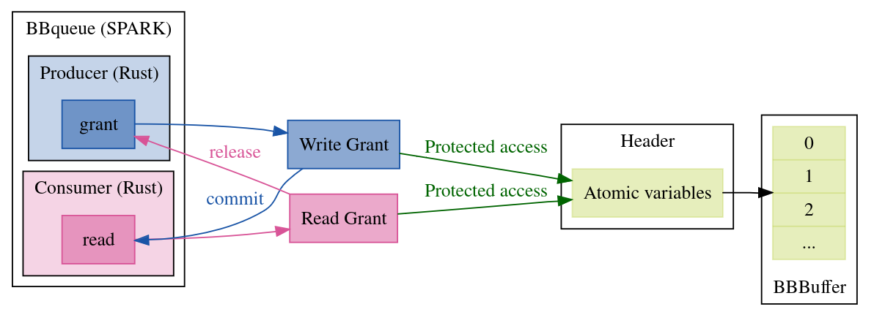
Method 5: BBQueue
Exists in Rust and SPARK
Formally proven in SPARK with invariants and the GNATprover
Data structures are complex enough, continuous memory blocks which makes it ideal for experiment
Method

Slide 15
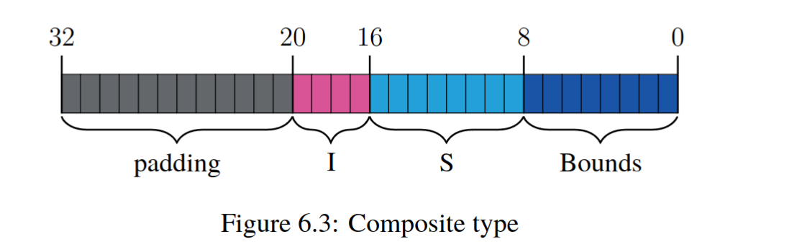
Experiments overview: stack
Simpler types, aggregates, composite types
Focus on type safety (memory safety and ownership taken care by the compiler for Copy)
Demonstrating memory errors, undefined behavior
Memory safety verified with valgrind
Working with compiler and language documentation
Working with layout
Experiments

Slide 16
Experiments overview: heap
Same as stack types, but in addition:
Defining data structure (“extra wrapper”) to hold complex and nested data types
Implementing native methods/traits for creating, accessing, and modifying complex data types
“Good FFI citizen”: Implementing method/traits for dereferencing and dropping memory after usage
Minimizing unsafe code and delegating to the language semantics as much as possible
// One function allocates memory for a new object.
extern fn ECDSA_SIG_new() -> *mut ECDSA_SIG;
// And another accepts a pointer created by new
// and deallocates it when the caller is done with it.
extern fn ECDSA_SIG_free(sig: *mut ECDSA_SIG);
J. Gjengset, Rust for Rustaceans [7]
Experiments

Slide 17
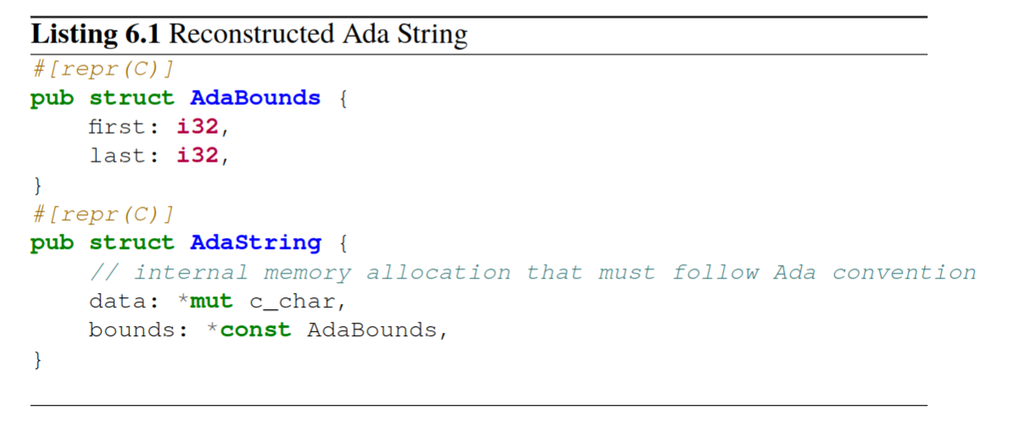
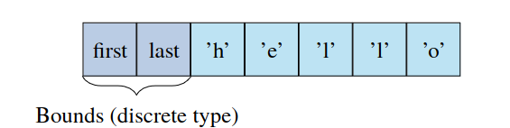
Example: SPARK String
String is a heap type: we need first to find correct sub-types (i32? c_char or u8?)
Fat pointer (bounds + array)
Finding instructions in the GNAT compiler book: bounds come last when FFI with C conventions.
Follow the C ABI
Experiments

Slide 18
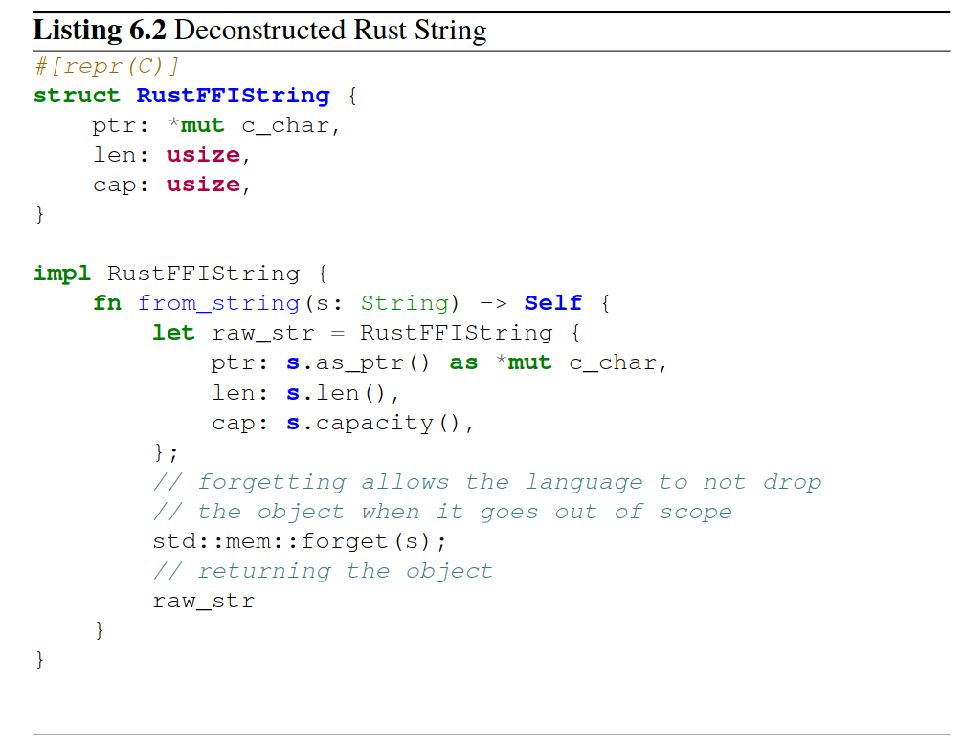
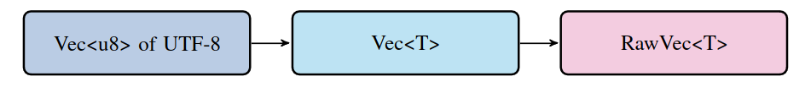
Example: Rust String
String is still a heap type: Vec of u8, building on inner types
Still a fat pointer with capacity, len, buffer
It is not FFI safe and cannot be exported
Must be encoded as c_char for Ada/SPARK (u8 will work but safety and consistency are key!) len and capacity are not Integers!
Forgetting must be implemented
Experiments

Slide 19
BBQueue
GrantW, GrantR → Header → Buffer
Grant holds a mutable reference to the header
The Grant can atomically touch the variables of the header
Experiments

Slide 20
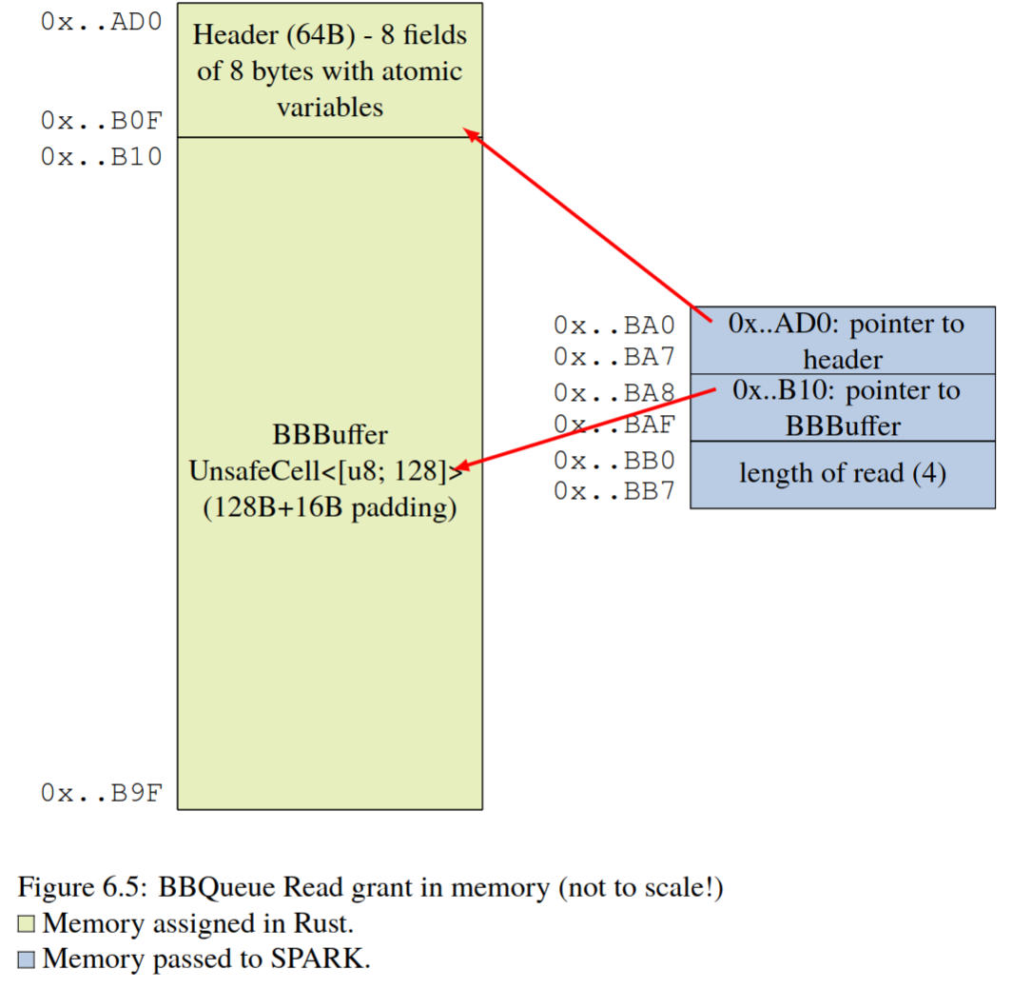
BBQueue
We must:
1. guarantee consistent layout across the FFI border (guaranteed by the data structure);
2. provide pointers to the grant and the content of the header;
3. ensure that the header fields are of the right size and are atomic;
4. ensure the absence of undefined behavior where it can be introduced;
5. ensure the functions in SPARK interact with the atomic variables in the exact prescribed order — to guarantee thread safety;
6. Respect the good FFI citizen principles.
Experiments

Slide 21
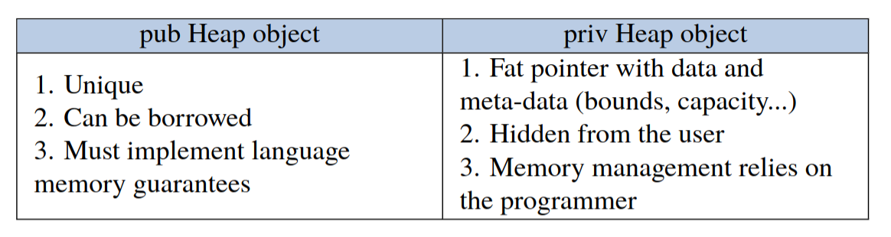
Results 1
Rely on documentation. It is spread between language and compiler docs.
Good FFI citizen (do not unwind, alloc/dealloc must be local) is a must and empirically no memory errors were found with valgrind
Great tooling is lost in transaction: the compiler, miri is not mature for FFI, same as GNATprove
It is extremely error prone as per literature.
References cannot be used across FFI! Back to pointer logic
Use separation of concerns
Results

Slide 22
Results 2: memory interaction
Some memory regions are inaccessible. SPARK must use named pointers.
SPARK is less flexible in its ownership (no lifetimes) in some respects (assumes ownership over the whole array in one function, no slicing)!
But SPARK is more flexible in memory allocation: storage pools. Rust has Allocator trait but not stabilized.
SPARK is more flexible to interact with external code/Rust protects most types
Results

Slide 23
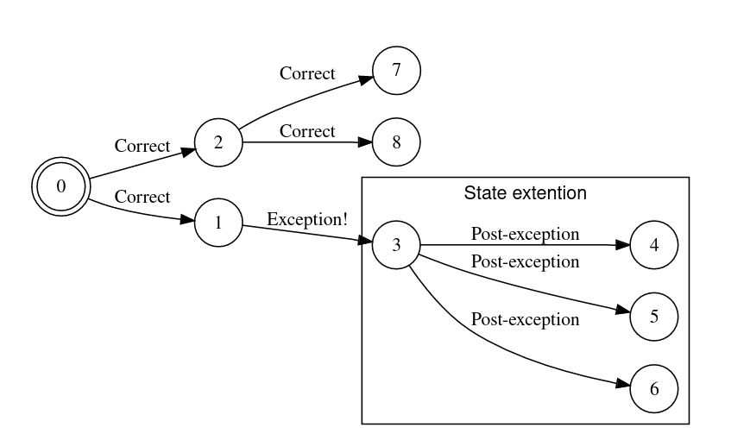
Results 3: Exceptions and panic!()
Unwinding across FFI is undefined behavior
In microcontrollers it is impossible to unwind
It is bad FFI citizen behavior!
SPARK has no support for exceptions
We can never go back to a “safe” state
Results

Slide 24
Conclusions: does Rust SPARK joy?
A tool is feasible but!
Gather information that is compiler and platform specific
If being careful the consistency of Rust SPARK is preserved,
but in case of error we are back to the weakest link
→ It becomes extremely easy to ”lie” to the compiler, human error etc
Strong reliance on the C ABI
Absence on tooling and compiler protection
Conclusion

Slide 25
Future work
Find/automate about types
Get inspiration from Bindgen/Cbindgen
Develop tooling for FFI Rust/SPARK
Assess performance
Formal verification!
Generalisations to other safe languages

Slide 26


Thank you for listening!

Slide 27
THANK YOU
[1] “NSA Releases Guidance on How to Protect Against Software Memory Safety Issues,” National Security Agency/Central Security Service, 2022. https://www.nsa.gov/Press-Room/News-Highlights/Article/Article/3215760/nsa-releases-guidance-on-how-to-protect-against-software-memory-safety-issues (accessed Feb. 13, 2023).
[2] S. Li, “Improving Quality of Soft ware with Foreign Function Interfaces using Static Analysis,” Doctoral dissertation, Lehigh University, 2014. Accessed: Feb. 13, 2023. [Online]. Available: https://www.semanticscholar.org/paper/Improving-Quality-of-Soft-ware-with-Foreign-using-Preserve-Li/8d0b6db3858946c27657567d42f684a32d34e4f3
[3] S. Mergendahl, N. Burow, and H. Okhravi, “Cross-Language Attacks,” in Proceedings 2022 Network and Distributed System Security Symposium, San Diego, CA, USA: Internet Society, 2022. doi: 10.14722/ndss.2022.24078.
[4] R. Pereira et al., “Energy efficiency across programming languages: how do energy, time, and memory relate?,” in Proceedings of the 10th ACM SIGPLAN International Conference on Software Language Engineering, in SLE 2017. New York, NY, USA: Association for Computing Machinery, Oct. 2017, pp. 256–267. doi: 10.1145/3136014.3136031.
[5] L. Soares, “Understanding Ownership in Rust with Examples,” Coinmonks, May 23, 2023. https://medium.com/coinmonks/understanding-ownership-in-rust-with-examples-73835ba931b1 (accessed May 24, 2023).
[6] J. Munns, “The design and implementation of a lock-free ring-buffer with contiguous reservations - Ferrous Systems,” Mar. 06, 2019. https://ferrous-systems.com/blog/lock-free-ring-buffer/ (accessed Apr. 28, 2023).
[7] J. Gjengset, Rust for Rustaceans. no starch press, 2021. Accessed: Mar. 06, 2023. [Online]. Available: https://rust-for-rustaceans.com
[8] L. Szekeres, M. Payer, Tao Wei, and D. Song, “SoK: Eternal War in Memory,” in 2013 IEEE Symposium on Security and Privacy, Berkeley, CA: IEEE, May 2013, pp. 48–62. doi: 10.1109/SP.2013.13.
[9] “Memory Safe Languages in Android 13,” Google Online Security Blog. https://security.googleblog.com/2022/12/memory-safe-languages-in-android-13.html (accessed May 25, 2023).

Slide 28
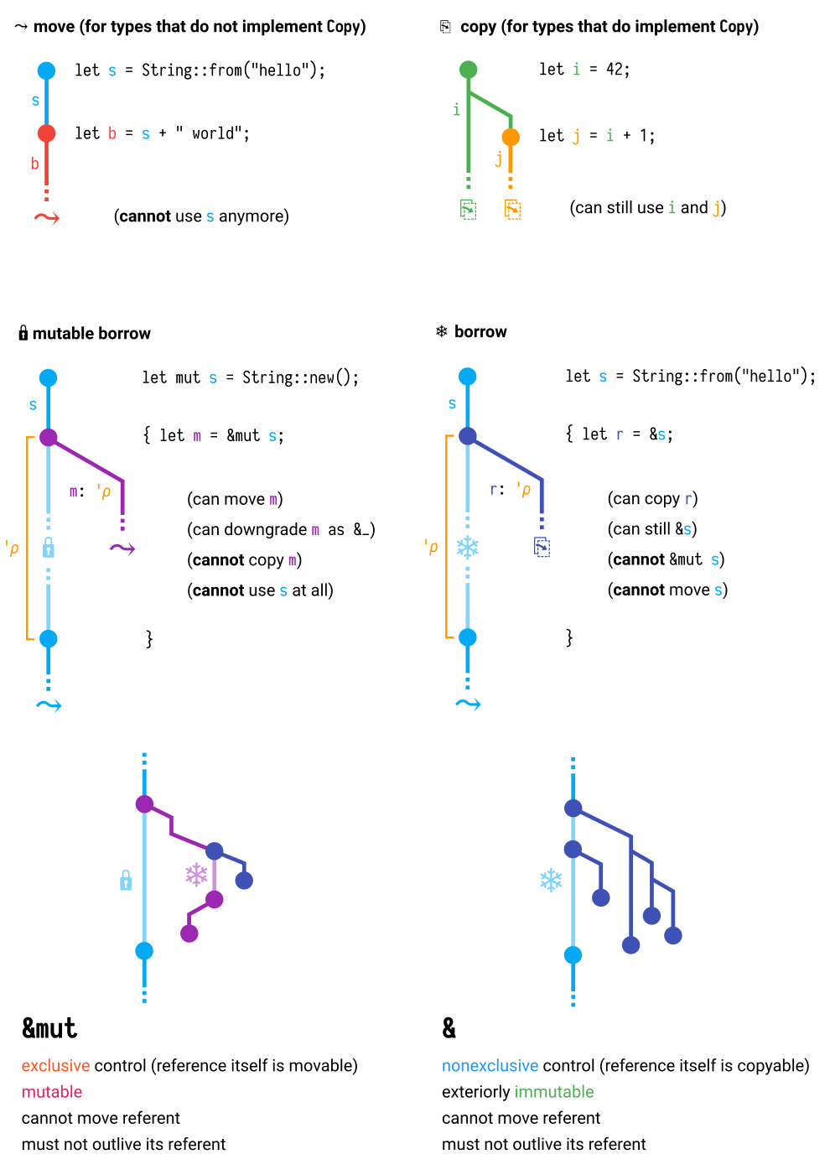
Copy and move semantics

Slide 29
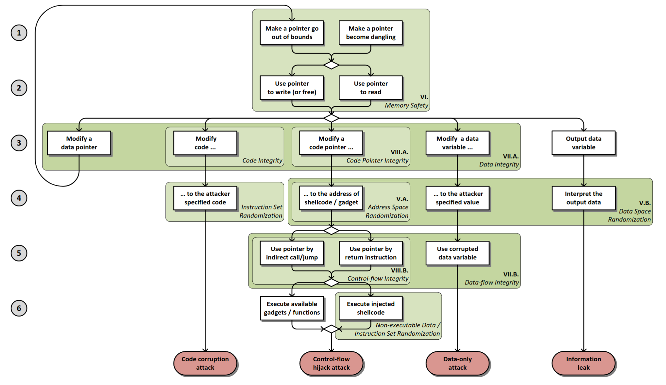
But what is wrong with C?
Memory Management: no garbage collector, no memory check at all.
Undefined Behavior: a lot of undefined behaviour, MISRA C cannot cover 27/143 (https://embeddedcomputing.com/technology/security/mirsa-c-cert-c-other-standards/the-place-for-misra-c-in-safe-secure-programming-a-comparison-with-spark)
Type Safety: weak, casts are authorized
Pointers: structurally equivalent. everything is possible
Concurrency
[8] L. Szekeres, M. Payer, Tao Wei, and D. Song, “SoK: Eternal War in Memory,”

Slide 30
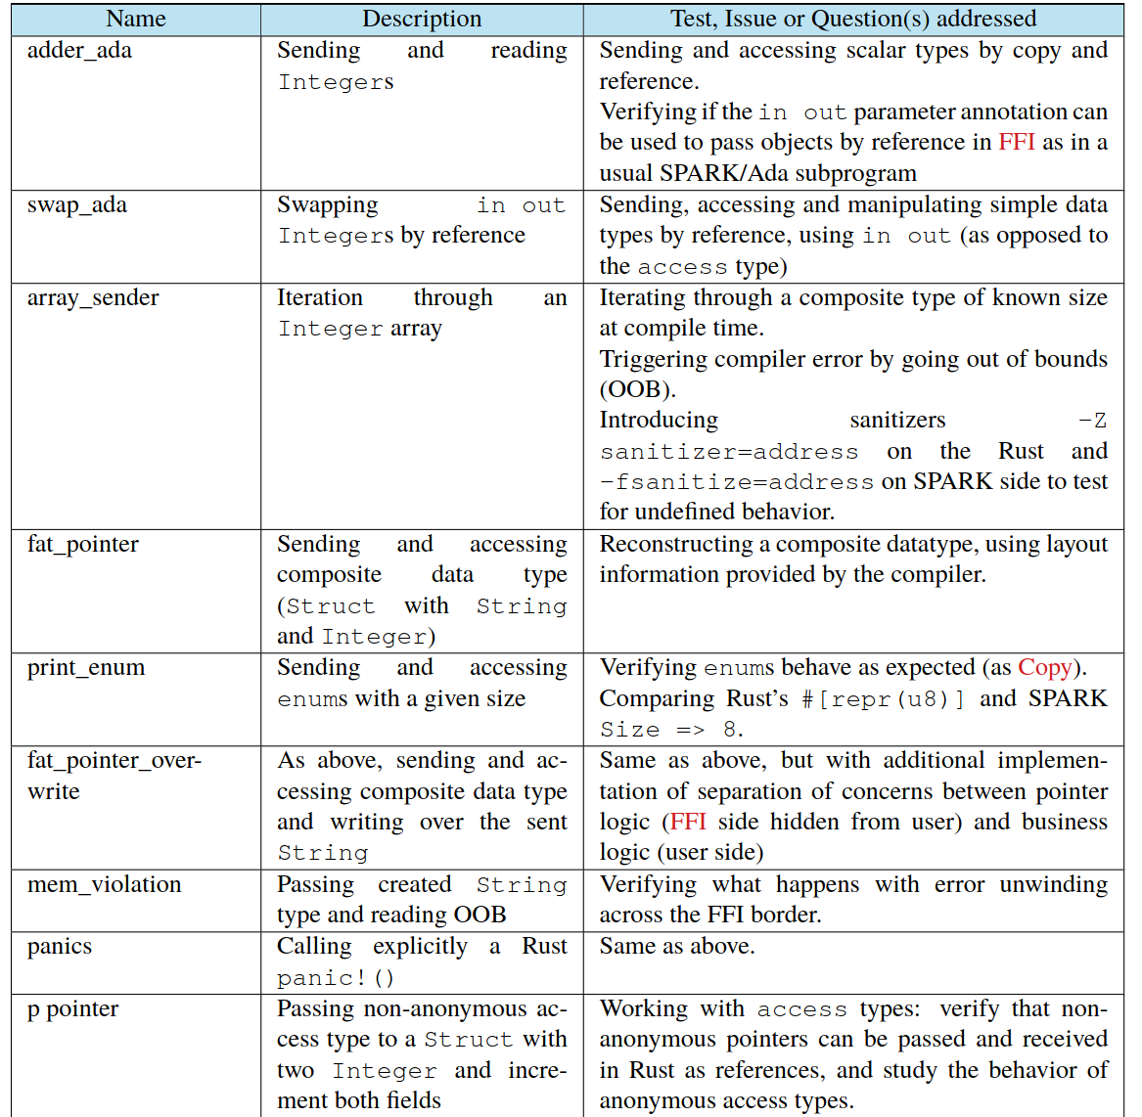
Experiments (1) Rust → SPARK
Experiments

Slide 31
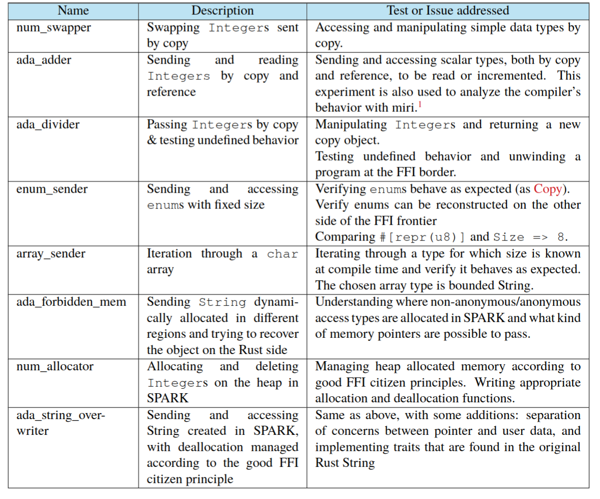
Experiments (1) SPARK → Rust
Experiments

Slide 32
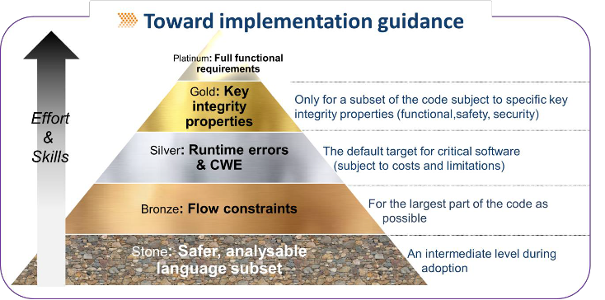
SPARK
+ MONEY!!
Experiments

Slide 33
Experiments (1) SPARK → Rust
Experiments

Slide 34
Experiments (1) SPARK → Rust
Experiments

